Slide 1
How to code control statements

Slide 2
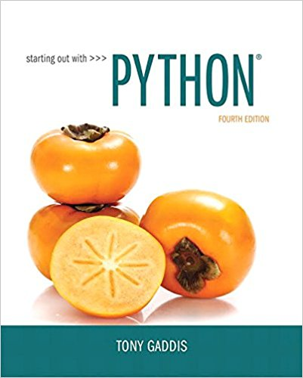
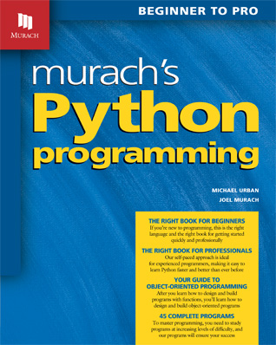
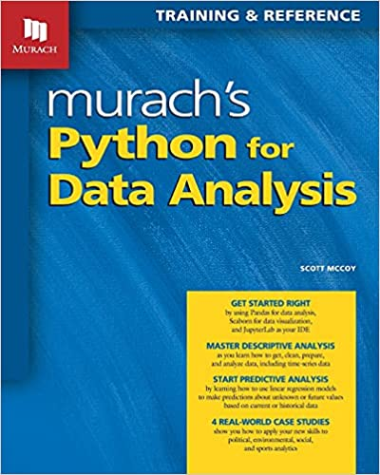
Slides are taken and adapted from:

Slide 3
Topics – Part 2: Loops
Introduction to Repetition Structures
The while Loop: a Condition-Controlled Loop
The for Loop: a Count-Controlled Loop
Calculating a Running Total
Sentinels
Input Validation Loops
Nested Loops

Slide 4
Introduction to Repetition Structures
Often have to write code that performs the same task multiple times
Disadvantages to duplicating code
Makes program large
Time consuming
May need to be corrected in many places
Repetition structure: makes computer repeat included code as necessary
Includes condition-controlled loops and count-controlled loops

Slide 5
The while Loop: a Condition-Controlled Loop
while loop: while condition is true, do something
Two parts:
Condition tested for true or false value
Statements repeated as long as condition is true
In flow chart, line goes back to previous part
General format:
while condition:
statements

Slide 6
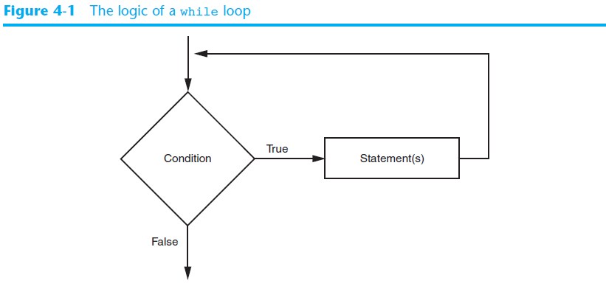
The while Loop: a Condition-Controlled Loop (cont’d.)

Slide 7
The while Loop: a Condition-Controlled Loop (cont’d.)
In order for a loop to stop executing, something has to happen inside the loop to make the condition false
Iteration: one execution of the body of a loop
while loop is known as a pretest loop
Tests condition before performing an iteration
Will never execute if condition is false to start with
Requires performing some steps prior to the loop

Slide 8
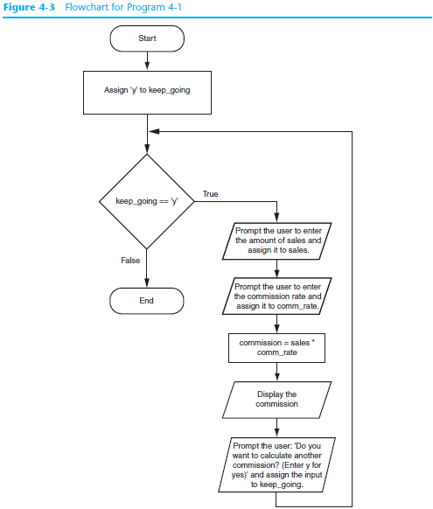

Slide 9
The syntax of the while statement

Slide 10
A while loop that prints the numbers 0 through 4 to the console

Slide 11
Infinite Loops
Loops must contain within themselves a way to terminate
Something inside a while loop must eventually make the condition false
Infinite loop: loop that does not have a way of stopping
Repeats until program is interrupted
Occurs when programmer forgets to include stopping code in the loop

Slide 12
Code that causes an infinite loop

Slide 13
Sentinels
Sentinel: special value that marks the end of a sequence of items
When program reaches a sentinel, it knows that the end of the sequence of items was reached, and the loop terminates
Must be distinctive enough so as not to be mistaken for a regular value in the sequence
Example: when reading an input file, empty line can be used as a sentinel

Slide 14
Input Validation Loops
Computer cannot tell the difference between good data and bad data
If user provides bad input, program will produce bad output
GIGO: garbage in, garbage out
It is important to design program such that bad input is never accepted

Slide 15
Input Validation Loops (cont’d.)
Input validation: inspecting input before it is processed by the program
If input is invalid, prompt user to enter correct data
Commonly accomplished using a while loop which repeats as long as the input is bad
If input is bad, display error message and receive another set of data
If input is good, continue to process the input

Slide 16
The user interface

Slide 17
Exercise
Write a program that reads and calculates the sum of an unspecified number of integers. The input 0 signifies the end of the input.
Write a program to find the factorial value of any positive number entered through the keyboard

Slide 18
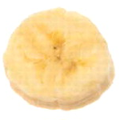
The for Loop: a Count-Controlled Loop
Count-Controlled loop: iterates a specific number of times
Use a for statement to write count-controlled loop
Designed to work with sequence of data items
Iterates once for each item in the sequence
General format:
for variable in [val1, val2, etc]:
statements
Target variable: the variable which is the target of the assignment at the beginning of each iteration

Slide 19
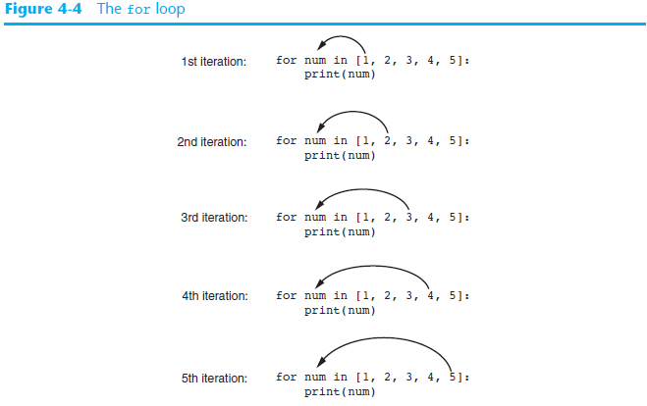

Slide 20
Using the range Function with the for Loop
The range function simplifies the process of writing a for loop
range returns an iterable object
Iterable: contains a sequence of values that can be iterated over
range characteristics:
One argument: used as ending limit
Two arguments: starting value and ending limit
Three arguments: third argument is step value

Slide 21
The syntax of a for loop with the range() function

Slide 22
A for loop that prints the numbers 0 through 4

Slide 23
Exercise
Write a program that prompts the user to enter two positive integers and finds their greatest common divisor.
Solution: Suppose you enter two integers 4 and 2, their greatest common divisor is 2. Suppose you enter two integers 16 and 24, their greatest common divisor is 8. So, how do you find the greatest common divisor? Let the two input integers be n1 and n2. You know number 1 is a common divisor, but it may not be the greatest commons divisor. So you can check whether k (for k = 2, 3, 4, and so on) is a common divisor for n1 and n2, until k is greater than n1 or n2.

Slide 24
Nested Loops
Nested loop: loop that is contained inside another loop
Key points about nested loops:
Inner loop goes through all of its iterations for each iteration of outer loop
Inner loops complete their iterations faster than outer loops
Total number of iterations in nested loop: number_iterations_inner x
number_iterations_outer

Slide 25
Exercise
Write a program that prints a multiplication table.
1*1=1 1*2=2 1*3=3 …………... 1*10=10
2*1=2 2*2=4 2*3=6 …………... 2*10=20
…………………………………………………….…….
…………………………………………………….…….
9*1=9 9*2=18 9*3=27 ………… 9*10=90

Slide 26
A break statement that exits an infinite while loop

Slide 27
A continue statement that jumps to the beginning of a while loop

